Slide 1
Linear Programming

Slide 2
Introduction to Linear Programming

Slide 3
Introduction to Linear Programming
Consider a business analyst who is trying to maximize the
profit from the production of a product or an engineer who
is trying to minimize the amount of energy an electric circuit
needs to operate.
Generally, problems that seek to maximize or minimize a
situation are called optimization problems.
One strategy for solving these problems was developed in
the 1940s and is called linear programming.

Slide 4
Introduction to Linear Programming
A linear programming problem involves a linear objective
function, which is the function that must be maximized or
minimized.
This objective function is subject to some constraints, which are inequalities or equations that restrict the values of the variables.
To illustrate these concepts, suppose a manufacturer produces 17- and 24-inch computer monitors. Past sales experience shows that at least twice as many 17-inch monitors are sold as 24-inch monitors.

Slide 5

Introduction to Linear Programming
Suppose further that the manufacturing plant is capable of producing 12 monitors per day.
Let x represent the number of 17-inch monitors produced per day, and let y represent the number of 24-inch monitors produced per day. Then
x ≥ 2y
x + y ≤ 12
These are the constraints.

Slide 6

Introduction to Linear Programming
These two inequalities place constraints, or restrictions, on the manufacturer. For example, the manufacturer cannot produce five 24-inch monitors per day, because that would require producing at least ten 17-inch monitors, and
5 + 10 12.
Suppose a profit of $50 is earned on each 17-inch monitor sold and $75 is earned on each 24-inch monitor sold. Then the manufacturer’s daily profit P, in dollars, is given by the equation
P = 50x + 75y
Objective function

Slide 7
Introduction to Linear Programming
The equation P = 50x + 75y defines the objective function.
The goal of this linear programming problem is to determine how many of each monitor should be produced to maximize the manufacturer’s profit and satisfy the constraints.
Because the manufacturer cannot produce fewer than zero units of either monitor, there are two other implied constraints: x ≥ 0 and y ≥ 0.

Slide 8

Introduction to Linear Programming
Our linear programming problem now looks like
Objective function P = 50x + 75y
x – 2y ≥ 0
Constraints x + y ≤ 12
x ≥ 0, y ≥ 0
To solve this problem, we graph the solution set of the constraints. The solution set of the constraints is called the set of feasible solutions.

Slide 9
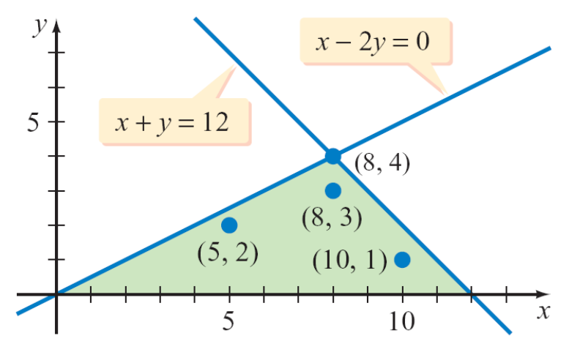
Introduction to Linear Programming
Ordered pairs in this set are used to evaluate the objective function to determine which ordered pair maximizes the profit. For example, (5, 2), (8, 3), and (10, 1) are three ordered pairs in the set. See Figure 9.29.
Figure 9.29

Slide 10
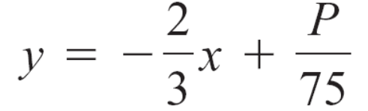
Introduction to Linear Programming
For these ordered pairs, the profits would be
P = 50(5) + 75(2) = 400
P = 50(8) + 75(3) = 625
P = 50(10) + 75(1) = 575
It would be impossible to check every ordered pair in the set of feasible solutions to find which one maximizes profit. Fortunately, we can find that ordered pair by solving the objective function P = 50x + 75y for y.
x = 5, y = 2
x = 8, y = 3
x = 10, y = 1

Slide 11


Introduction to Linear Programming
In this form, the objective function is a linear equation
whose graph has a slope of and a y-intercept of .
If P is as large as possible (P a maximum), then the
y-intercept will be as large as possible.
Thus the maximum profit will occur on the line that has a
slope of , has the largest possible y-intercept, and
intersects the set of feasible solutions.

Slide 12
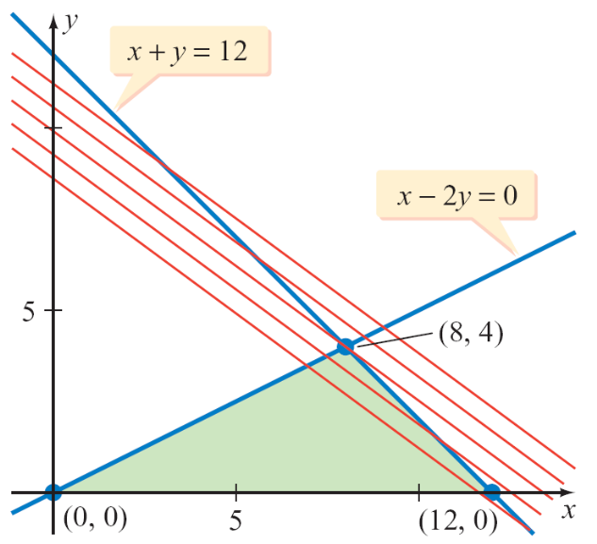
Introduction to Linear Programming
From Figure 9.30, the largest possible y-intercept occurs
when the line passes through the point with the coordinates
(8, 4). At this point, the profit is
P = 50(8) + 75(4) = 700
Figure 9.30

Slide 13
Introduction to Linear Programming
The manufacturer will maximize profit by producing
8 17-inch monitors and 4 24-inch monitors each day. The
profit will be $700 per day.
In general, the goal of any linear programming problem is
to maximize or minimize the objective function, subject to
the constraints. Minimization problems occur, for example,
when a manufacturer wants to minimize the cost of
operations.

Slide 14

Introduction to Linear Programming
Suppose that a cost minimization problem results in the following objective function and constraints.
Objective function C = 3x + 4y
x + y ≥ 1
2x – y ≤ 5
x + 2y ≤ 10
x ≥ 0, y ≥ 0
Constraints

Slide 15
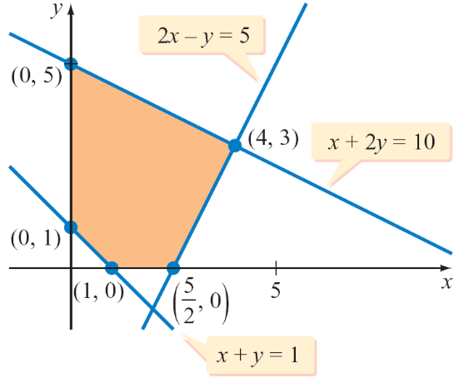
Introduction to Linear Programming
Figure 9.31 is the graph of the solution set of the constraints. The task is to find the ordered pair that satisfies all the constraints and gives the smallest value of C.
We again could solve the objective function for y and, because we want to minimize C, find the smallest
y-intercept.
Figure 9.31

Slide 16
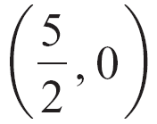
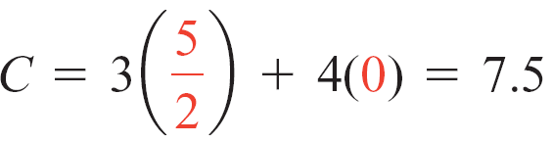
Introduction to Linear Programming
Fundamental Linear Programming Theorem
If an objective function has an optimal solution, then that solution will be at a vertex of the set of feasible solutions.
Following is a list of the values of C at the vertices. The minimum value of the objective function occurs at the point whose coordinates are (1, 0).
(x, y) C = 3x + 4y
(1, 0) C = 3(1) + 4(0) = 3
Minimum

Slide 17
Introduction to Linear Programming
(4, 3) C = 3(4) + 4(3) = 24
(0, 5) C = 3(0) + 4(5) = 20
(0, 1) C = 3(0) + 4(1) = 4
The maximum value of the objective function can also be determined from the list. It occurs at (4, 3).
Maximum

Slide 18
Introduction to Linear Programming
It is important to realize that the maximum or minimum value of an objective function depends on the objective function and on the set of feasible solutions.
For example, using the set of feasible
solutions in Figure 9.31 but changing
the objective function to C = 2x + 5y
changes the maximum value of C to 25,
at the ordered pair (0, 5). You should
verify this result by making a list.
Figure 9.31

Slide 19
Solving Optimization Problems

Slide 20

Example 1 – Solve a Minimization Problem
Minimize the objective function C = 4x + 7y with the constraints
3x + y ≥ 6
x + y ≥ 4
x + 3y ≥ 6
x ≥ 0, y ≥ 0

Slide 21
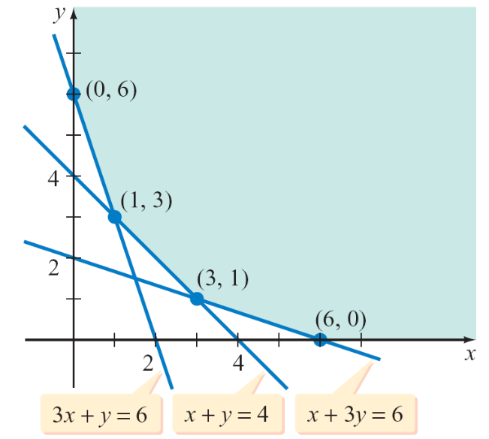
Example 1 – Solution
Determine the set of feasible
solutions by graphing the solution
set of the inequalities.
See Figure 9.32.
Note that in this instance the set
of feasible solutions is an
unbounded region with four vertices.
The vertex on the y-axis is the y-intercept of the line
3x + y = 6, which is (0, 6).
Figure 9.32

Slide 22

Example 1 – Solution
cont’d
The vertex on the x-axis is the x-intercept of the line
x + 3y = 6, which is (6, 0).
To find the other two vertices of the region, solve the
following systems of equations.
3x + y = 6 x + 3y = 6
x + y = 4 x + y = 4
The solutions of the two systems are (1, 3) and (3, 1),
respectively.

Slide 23
Example 1 – Solution
cont’d
Evaluate the objective function at each of the four vertices of the set of feasible solutions.
(x, y) C = 4x + 7y
(0, 6) C = 4(0) + 7(6) = 42
(1, 3) C = 4(1) + 7(3) = 25
(3, 1) C = 4(3) + 7(1) = 19
(6, 0) C = 4(6) + 7(0) = 24
The minimum value of the objective function is 19 at (3, 1).
Minimum

